Slide 1
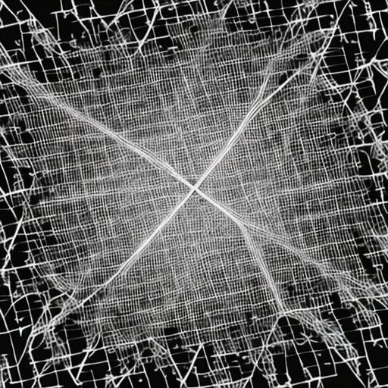
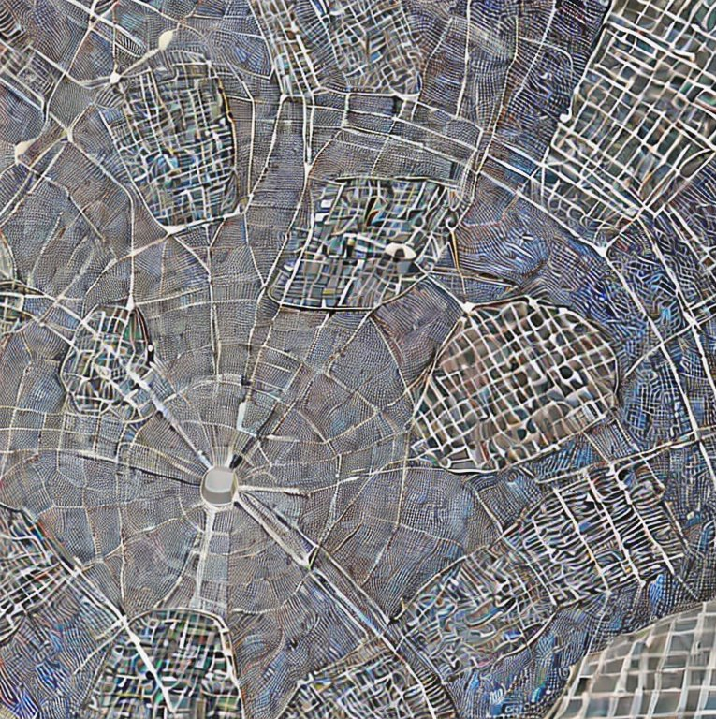
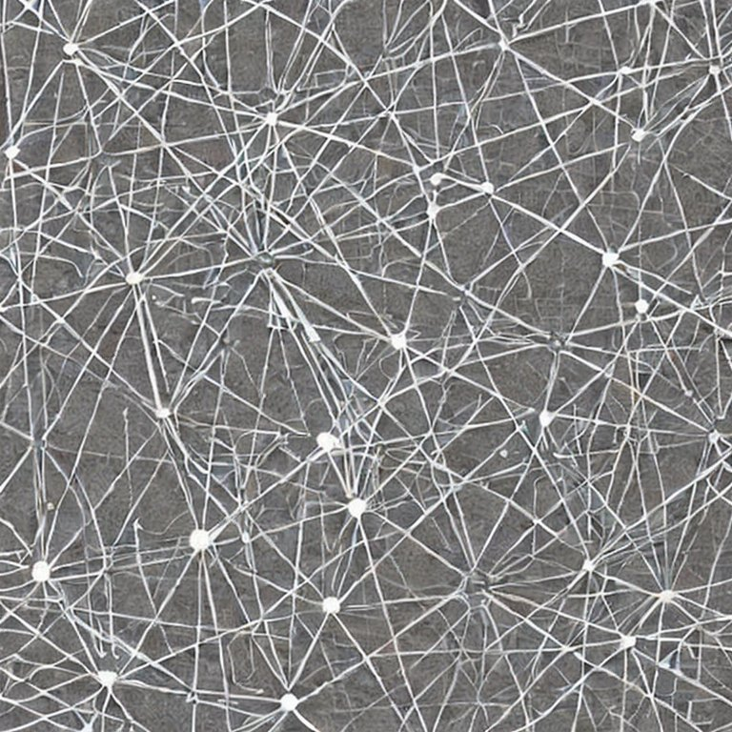
Eulerian and Hamiltonian Graphs
Mohammed Brahimi
Eulerian and Hamiltonian Graphs

Slide 2
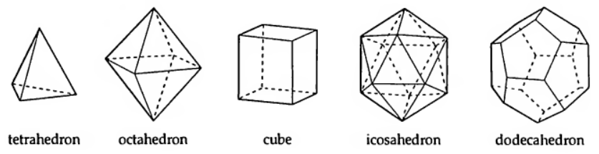
Platonic Graphs
How to start at one vertex and visit all edges before returning to it ?

Slide 3
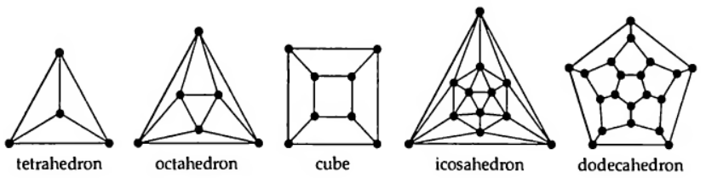
Platonic Graphs

Slide 4
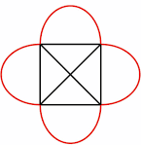

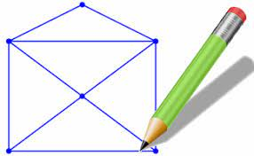
Draw without lifting pencil puzzles

Slide 5
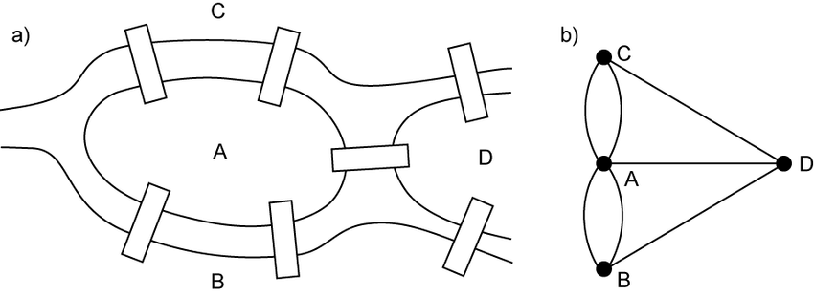
Konigsberg bridge problem

Slide 6
Explorer and Traveller
Explorer's Problem
An explorer wishes to find a tour that traverses each road exactly once and returns to the starting point.
Traveller's Problem
A traveller wishes to find a tour that visits each city exactly once and returns to the starting point.

Slide 7
Eulerian vs Hamiltonian
A connected graph is Eulerian if it contains a closed trail that includes every edge; such a trail is an Eulerian trail.
A connected graph is Semi-Eulerian if there exists a (non-closed) trail that includes every edge of G.
A connected graph is Hamiltonian if it contains a cycle that includes every vertex; such a cycle is a Hamiltonian cycle.
A connected graph is Semi-Hamiltonian if there exists a (non-closed) cycle that includes every vertex of G.

Slide 8
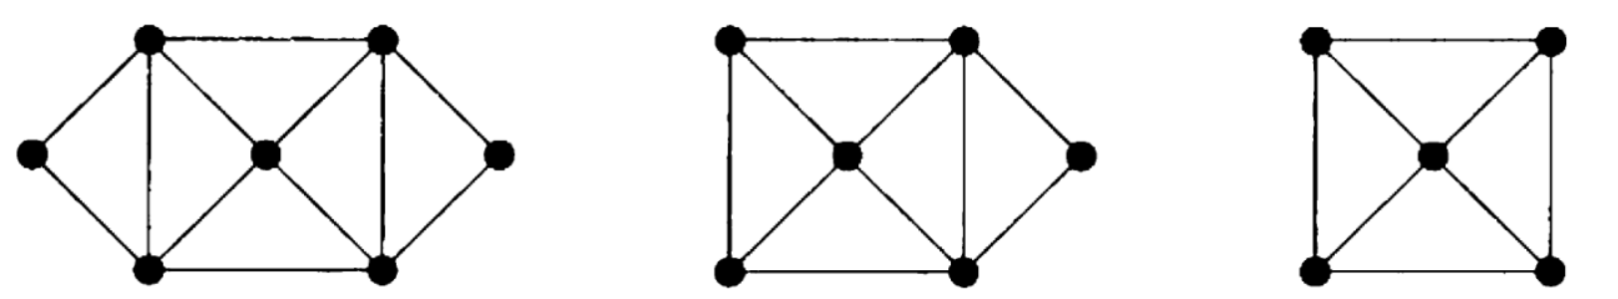
Eulerian ? Semi- Eulerian ?
Eulerian
Semi-Eulerian
Non-Eulerian

Slide 9
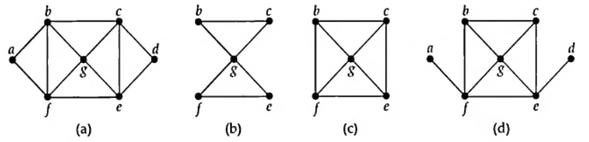
Hamiltonian ? Semi-Hamiltonian ?
Eulerian Hamiltonian
Eulerian
Semi-Hamiltonian
Not Eulerian Hamiltonian
Not Eulerian
Semi Hamiltonian
a b c d e f b g c e g f a b c d e g f a
b c g f e g b
b c g e f b

Slide 10
Eulerian Graphs and digraphs

Slide 11
Lemma 1
If G is graph in which the degree of each vertex is at least two, then G contains a cycle.

Slide 12
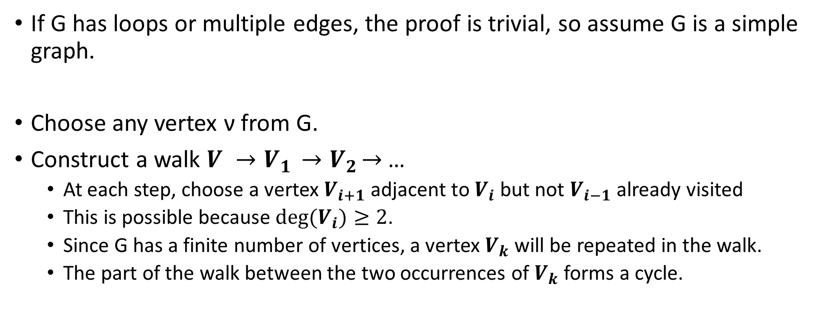
Proof of lemma1
If G has loops or multiple edges, the proof is trivial, so assume G is a simple graph.
Choose any vertex ν from G.
Construct a walk ${V →V}_{1}{ →V}_{2}→$ …
At each step, choose a vertex $V_{i+1}$ adjacent to $V_{i}$ but not $V_{i−1}$ already visited
This is possible because $deg(V_{i})≥2$.
Since G has a finite number of vertices, a vertex $V_{k}$ will be repeated in the walk.
The part of the walk between the two occurrences of $V_{k}$ forms a cycle.

Slide 13
Theorem 2 (Euler, 1735)
A connected graph is Eulerian if and only if each vertex has even degree.
This Theorem gives a necessary and sufficient condition for a connected graph to be Eulerian.
It is equivalent to the following two statements for a connected graph G:
if G is Eulerian, then each vertex of G has even degree.
if each vertex of G has even degree, then G is Eulerian.

Slide 14
Proof ➔
if G is Eulerian, then each vertex of G has even degree.
Let G be a graph and P be an Eulerian trail of G.
Whenever P passes through a vertex, its degree increased by 2.
Since each edge in P occurs exactly once, the degree of each vertex is even

Slide 15
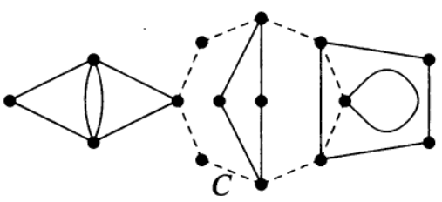
Proof ⬅
Proof by induction on the number of edges in G.
Assume that each vertex of G has an even degree.
G should contains a cycle C by Lemma 1.
If C includes all edges of G, the proof is done.
Otherwise, remove edges of C from G to create a new graph H with fewer edges.
Each vertex in H still has even degree.
By induction, each component of H has an Eulerian trail.
Each component of H has at least one vertex in common with C.
Combine the initial cycle C and the cycles of each component to get the required Eulerian trail.

Slide 16
Corollary 1
An Eulerian graph can be split into cycles, no two of which have an edge in common.
Proof
Similar to the proof of theorem 2 (direction ⬅)
Build initial cycle C
Remove the edges of this cycle
Build a cycle for each component

Slide 17
Corollary 2
A connected graph is semi-Eulerian if and only if it has exactly two vertices of odd degree.
A semi-Eulerian trail must start and end at vertices with odd degrees.
According to the handshaking lemma, a graph cannot have only one vertex with an odd degree.

Slide 18
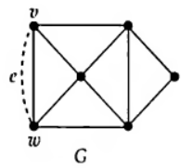
Proof (➔)
If G is semi-Eulerian, then G has exactly two vertices of odd degree.
Assume that G is semi-Eulerian graph.
Add an edge e between the starting vertex v and finishing vertex w of an open trail.
The result is an Eulerian graph in which all vertices have even degree (Theorem 2).
By removing the edge e, we can return back to the semi-Eulerian graph G, where only the vertices v and w have odd degrees.

Slide 19
Proof (⬅)
If a connected graph G has exactly two vertices of odd degree, then G is semi-Eulerian.
Let G be a graph with exactly two vertices of odd degree, v and w.
Add an edge e joining v and w; then we obtain a connected graph in which each vertex has even degree.
This graph is Eulerian, and so has an Eulerian trail (Theorem 2).
Removal of the edge e from this trail produces an open trail that includes every edge of G, so G is semi-Eulerian.

Slide 20
How to construct the Eulerian trail ?
Theorem 3 (Fleury’s algorithm)
If G is an Eulerian graph. Then the following construction is always possible, and produce an Eulerian trail of G.
Start at any vertex and traverse the edges in an arbitrary manner, subject only to the following rules:
Erase the edges as they are traversed, and if any isolated vertices result, erase them too;
At each stage, use a bridge only if there is no alternative.
Proof
Exercise

Slide 21
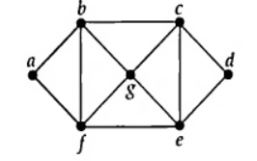
Example

Slide 22
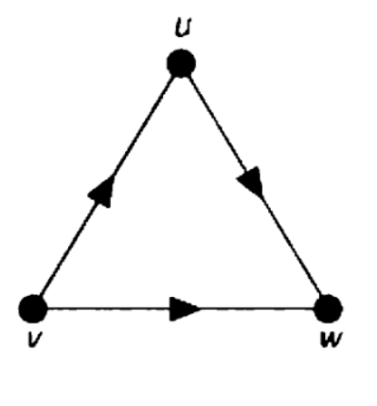
Eulerian digraphs
A connected digraph D is Eulerian if there exists a closed directed trail that includes every arc of D such a trail is an Eulerian trail.
The digraph must be strongly connected for an Eulerian trail to exist.
Any Eulerian graph is orientable, since we simply follow any Eulerian trail.

Slide 23
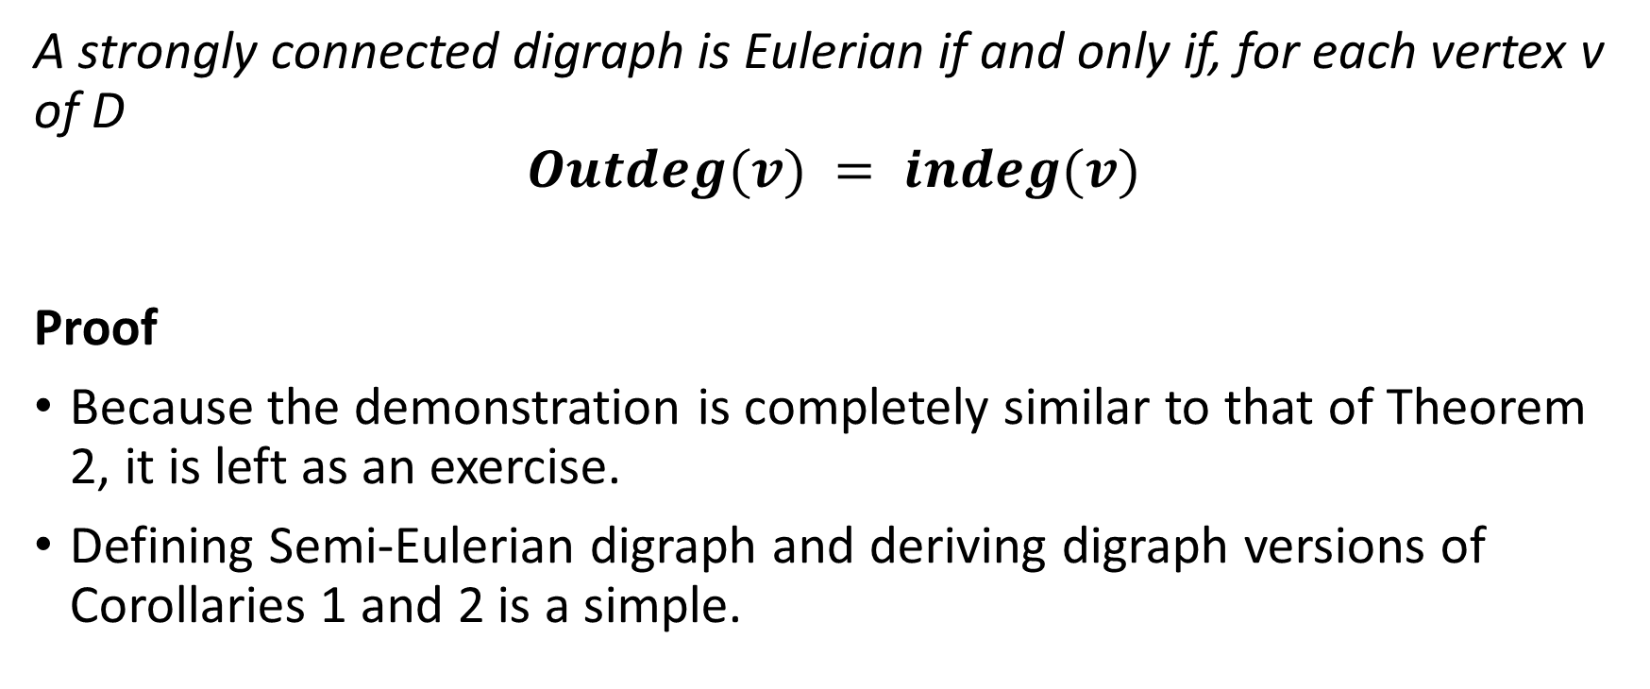
Theorem 4
A strongly connected digraph is Eulerian if and only if, for each vertex v of D
$$Outdeg(v) = indeg(v)$$
Proof
Because the demonstration is completely similar to that of Theorem 2, it is left as an exercise.
Defining Semi-Eulerian digraph and deriving digraph versions of Corollaries 1 and 2 is a simple.

Slide 24
Hamiltonian graphs and digraphs

Slide 25
Hamiltonian graphs
We found the necessary and sufficient conditions for a connected graph to be Eulerian and aim to obtain similair characterizations for Hamiltonian graphs
But no such characterization is known. In fact, little is known in general about Hamiltonian graphs, and most results have the form 'if G has enough edges, then G is Hamiltonian’.
Probably the most celebrated of these is Dirac's theorem, due to G. A. Dirac Corollary deduced it from the Ore Theorem.

Slide 26
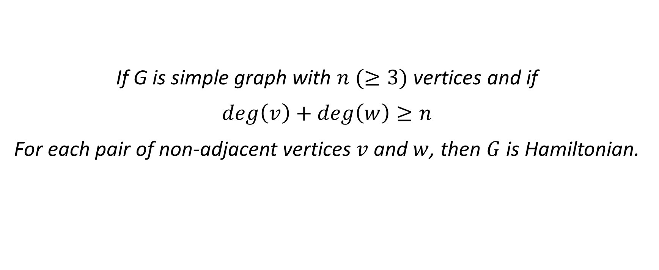
Theorem 3 (Ore, 1960)
If G is simple graph with $n (≥3)$ vertices and if
$$\deg\left(v\right)+\deg\left(w\right)≥n$$
For each pair of non-adjacent vertices $v$ and $w$, then $G$ is Hamiltonian.

Slide 27
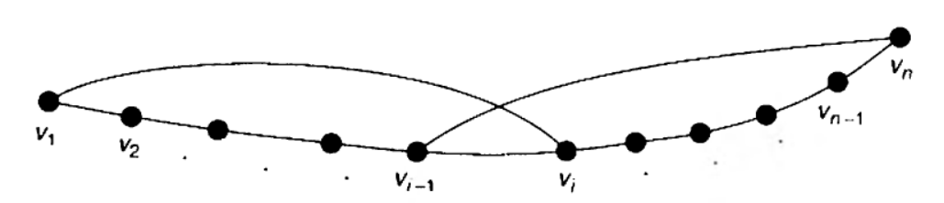
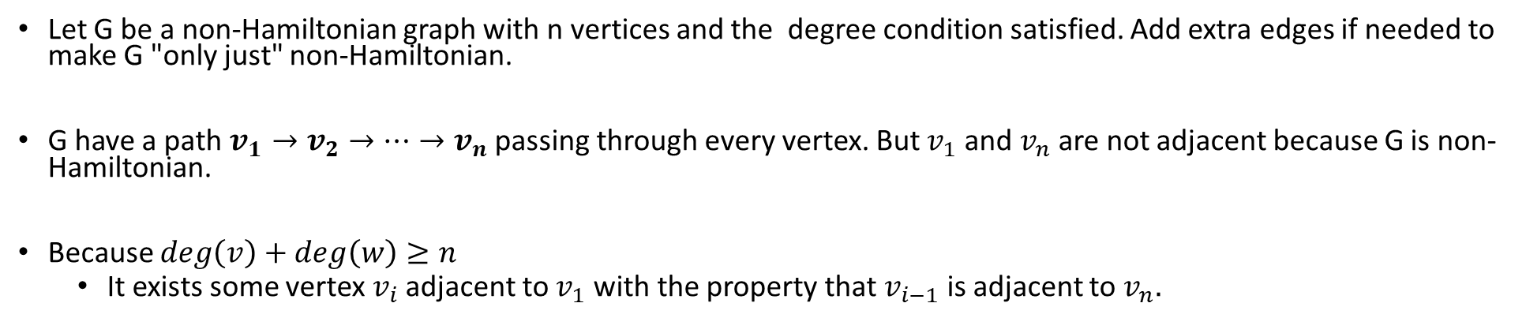

Proof
Let G be a non-Hamiltonian graph with n vertices and the degree condition satisfied. Add extra edges if needed to make G "only just" non-Hamiltonian.
G have a path $v_{1}→v_{2}→…→v_{n}$ passing through every vertex. But $v_{1}$ and $v_{n}$ are not adjacent because G is non-Hamiltonian.
Because $\deg\left(v\right)+\deg\left(w\right)≥n$
It exists some vertex $v_{i}$ adjacent to $v_{1}$ with the property that $v_{i−1}$is adjacent to $v_{n}.$
We can construct a Hamiltonian cycle:
$$v_{1}→v_{2}→…→v_{i−1}→v_{n}→v_{n−1}→…→v_{i}→v_{1}$$
G' is Hamiltonian, contradicting the assumption that G is non-Hamiltonian.

Slide 28
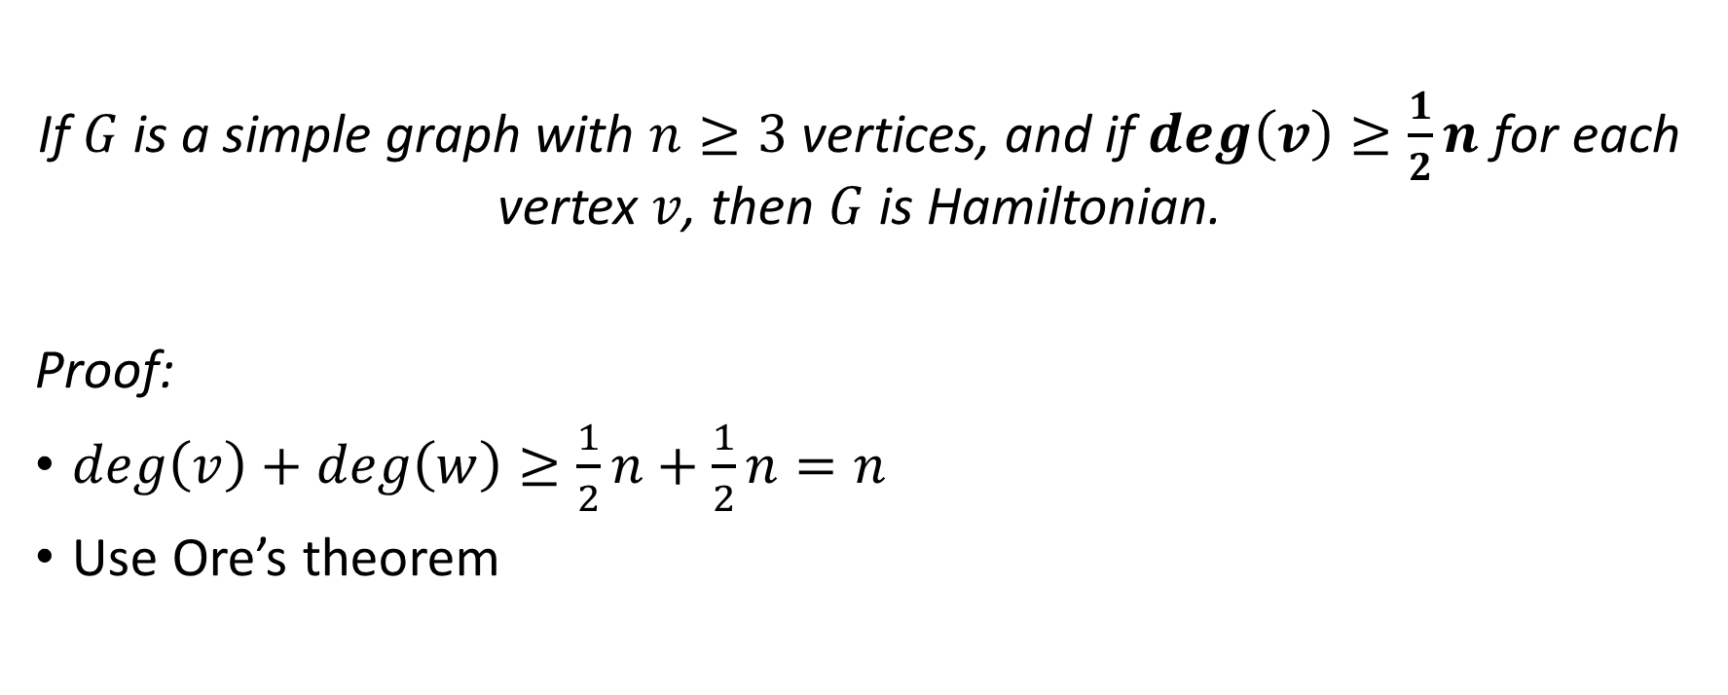
Corollary 3 (Dirac, 1952)
If $G$ is a simple graph with $n≥3$ vertices, and if $\deg\left(v\right)≥\frac{1}{2}n$ for each vertex $v$, then $G$ is Hamiltonian.
Proof:
$\deg\left(v\right)+$ $\deg\left(w\right)≥\frac{1}{2}n+\frac{1}{2}n=n$
Use Ore’s theorem

Slide 29
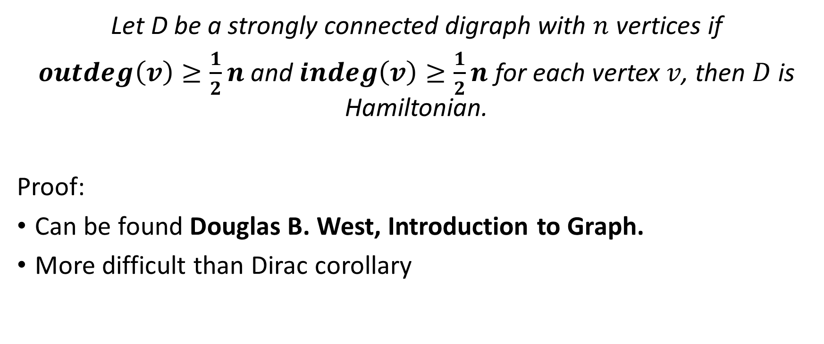
Hamiltonian Digraph (M. A. Ghouila-Houri)
Let D be a strongly connected digraph with $n$ vertices if
$outdeg\left(v\right)≥\frac{1}{2}n$ and $indeg\left(v\right)≥\frac{1}{2}n$ for each vertex $v$, then $D$ is Hamiltonian.
Proof:
Can be found Douglas B. West, Introduction to Graph.
More difficult than Dirac corollary

Slide 30
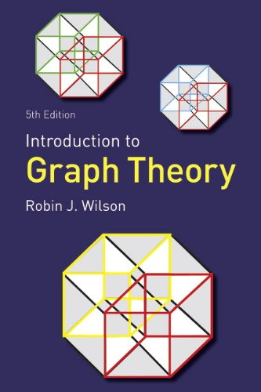
Reference text book

